Slide 1
CHAPTER 16
Managing Bond Portfolios

Slide 2
Bond Pricing Relationships
Bond prices and yields are inversely related.
An increase in a bond’s yield to maturity results in a smaller price change than a decrease of equal magnitude.
Long-term bonds tend to be more price sensitive than short-term bonds.

Slide 3
Bond Pricing Relationships
As maturity increases, price sensitivity increases at a decreasing rate.
Interest rate risk is inversely related to the bond’s coupon rate.
Price sensitivity is inversely related to the yield to maturity at which the bond is selling.

Slide 4
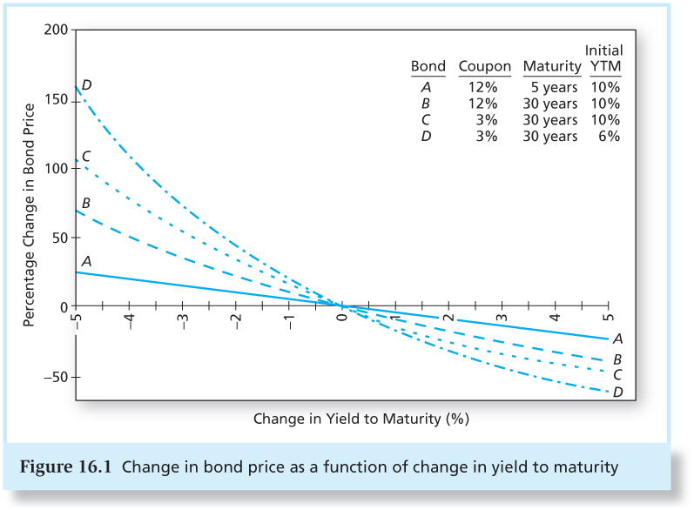
Figure 16.1 Change in Bond Price as a Function of Change in Yield to Maturity

Slide 5
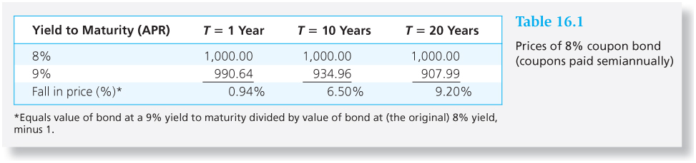
Table 16.1 Prices of 8% Coupon Bond (Coupons Paid Semiannually)

Slide 6
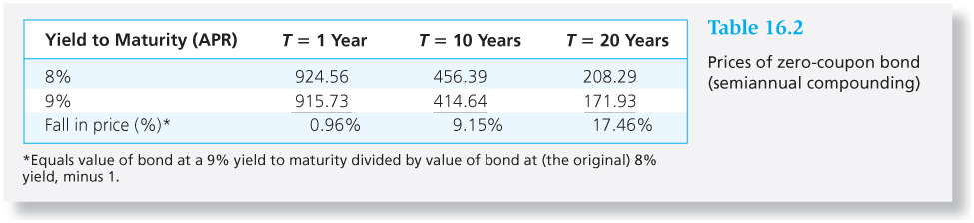
Table 16.2 Prices of Zero-Coupon Bond (Semiannually Compounding)

Slide 7
Duration
A measure of the effective maturity of a bond
The weighted average of the times until each payment is received, with the weights proportional to the present value of the payment
Duration is shorter than maturity for all bonds except zero coupon bonds.
Duration is equal to maturity for zero coupon bonds.

Slide 8
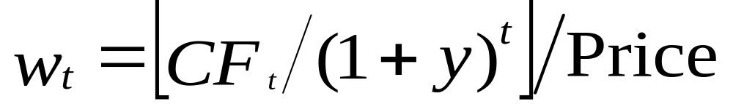
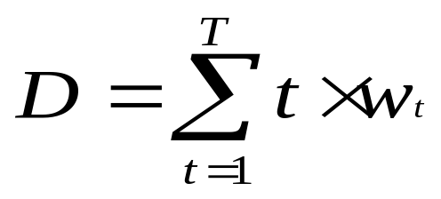
Duration: Calculation
CF_{t}=cash flow at time t

Slide 9
Duration/Price Relationship
Price change is proportional to duration and not to maturity
D* = modified duration

Slide 10
Example 16.1 Duration
Two bonds have duration of 1.8852 years. One is a 2-year, 8% coupon bond with YTM=10%. The other bond is a zero coupon bond with maturity of 1.8852 years.
Duration of both bonds is 1.8852 x 2 = 3.7704 semiannual periods.
Modified D = 3.7704/1+0.05 = 3.591 periods

Slide 11
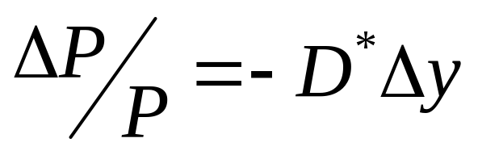
Example 16.1 Duration
Suppose the semiannual interest rate increases by 0.01%. Bond prices fall by:
=-3.591 x 0.01% = -0.03591%
Bonds with equal D have the same interest rate sensitivity.

Slide 12
Example 16.1 Duration
Coupon Bond
Zero
The coupon bond, which initially sells at $964.540, falls to $964.1942 when its yield increases to 5.01%
percentage decline of 0.0359%.
The zero-coupon bond initially sells for $1,000/1.05 ^{3.7704} = $831.9704.
At the higher yield, it sells for $1,000/1.05^{3.7704} = $831.6717. This price also falls by 0.0359%.

Slide 13
Rules for Duration
Rule 1 The duration of a zero-coupon bond equals its time to maturity
Rule 2 Holding maturity constant, a bond’s duration is higher when the coupon rate is lower
Rule 3 Holding the coupon rate constant, a bond’s duration generally increases with its time to maturity

Slide 14
Rules for Duration
Rule 4 Holding other factors constant, the duration of a coupon bond is higher when the bond’s yield to maturity is lower
Rules 5 The duration of a level perpetuity is equal to: (1+y) / y

Slide 15
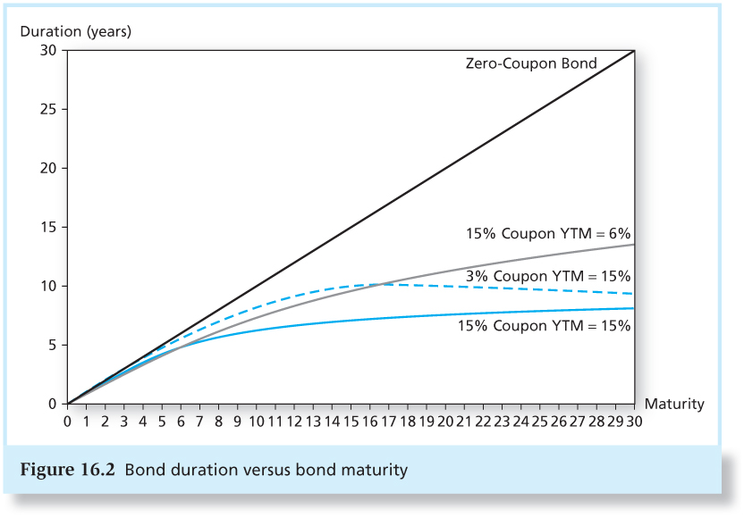
Figure 16.2 Bond Duration versus
Bond Maturity

Slide 16
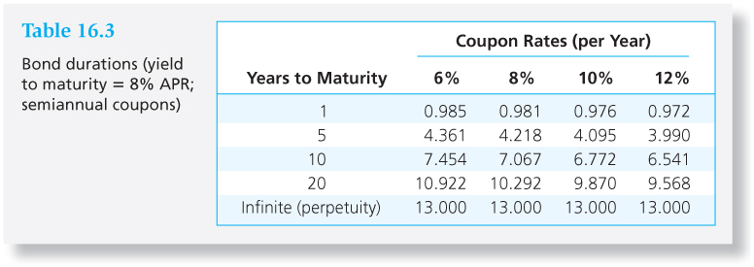
Table 16.3 Bond Durations (Yield to Maturity = 8% APR; Semiannual Coupons)

Slide 17
Convexity
The relationship between bond prices and yields is not linear.
Duration rule is a good approximation for only small changes in bond yields.
Bonds with greater convexity have more curvature in the price-yield relationship.

Slide 18
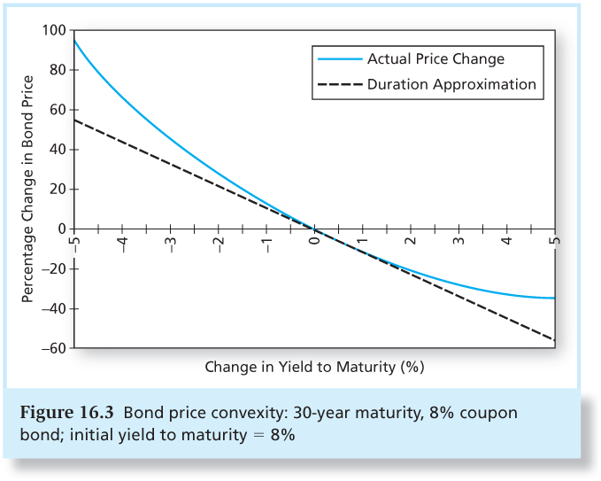
Figure 16.3 Bond Price Convexity: 30-Year Maturity, 8% Coupon; Initial YTM = 8%

Slide 19
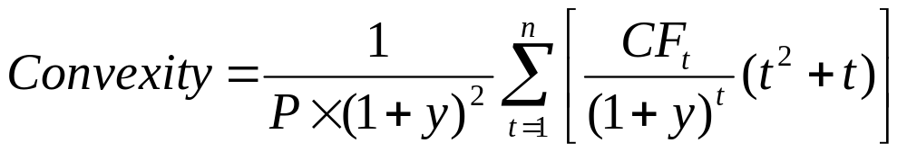
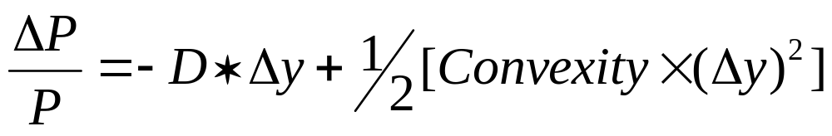
Convexity
Correction for Convexity:

Slide 20
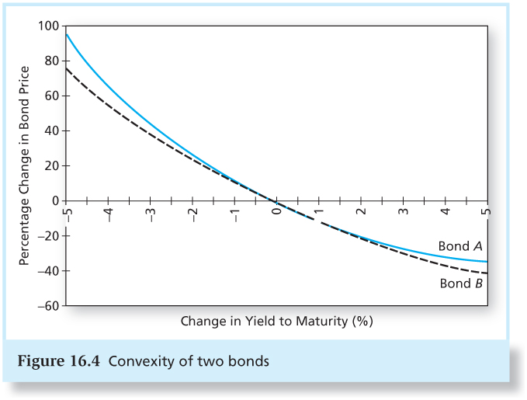
Figure 16.4 Convexity of Two Bonds

Slide 21
Why do Investors Like Convexity?
Bonds with greater curvature gain more in price when yields fall than they lose when yields rise.
The more volatile interest rates, the more attractive this asymmetry.
Bonds with greater convexity tend to have higher prices and/or lower yields, all else equal.

Slide 22
Callable Bonds
As rates fall, there is a ceiling on the bond’s market price, which cannot rise above the call price.
Negative convexity
Use effective duration:

Slide 23
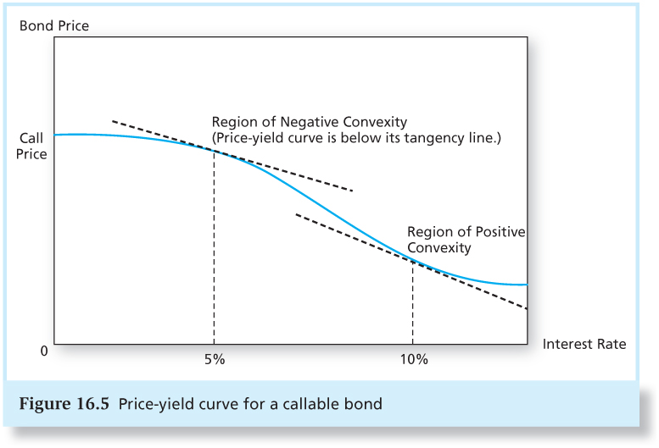
Figure 16.5 Price –Yield Curve for a Callable Bond

Slide 24
Mortgage-Backed Securities
The number of outstanding callable corporate bonds has declined, but the MBS market has grown rapidly.
MBS are based on a portfolio of callable amortizing loans.
  Homeowners have the right to repay their loans at any time.
  MBS have negative convexity.

Slide 25
Mortgage-Backed Securities
Often sell for more than their principal balance.
Homeowners do not refinance as soon as rates drop, so implicit call price is not a firm ceiling on MBS value.
Tranches – the underlying mortgage pool is divided into a set of derivative securities

Slide 26
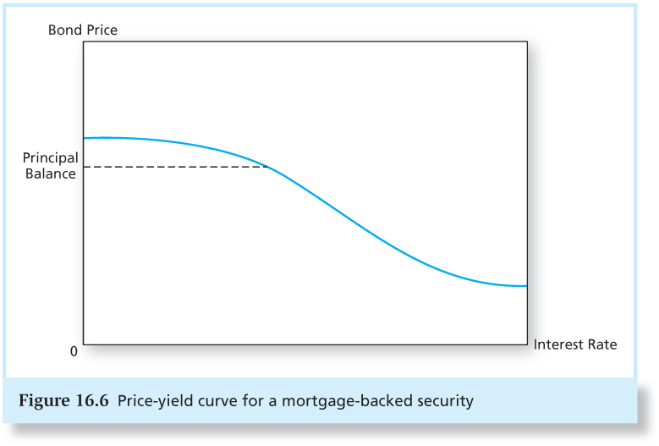
Figure 16.6 Price-Yield Curve for a Mortgage-Backed Security

Slide 27
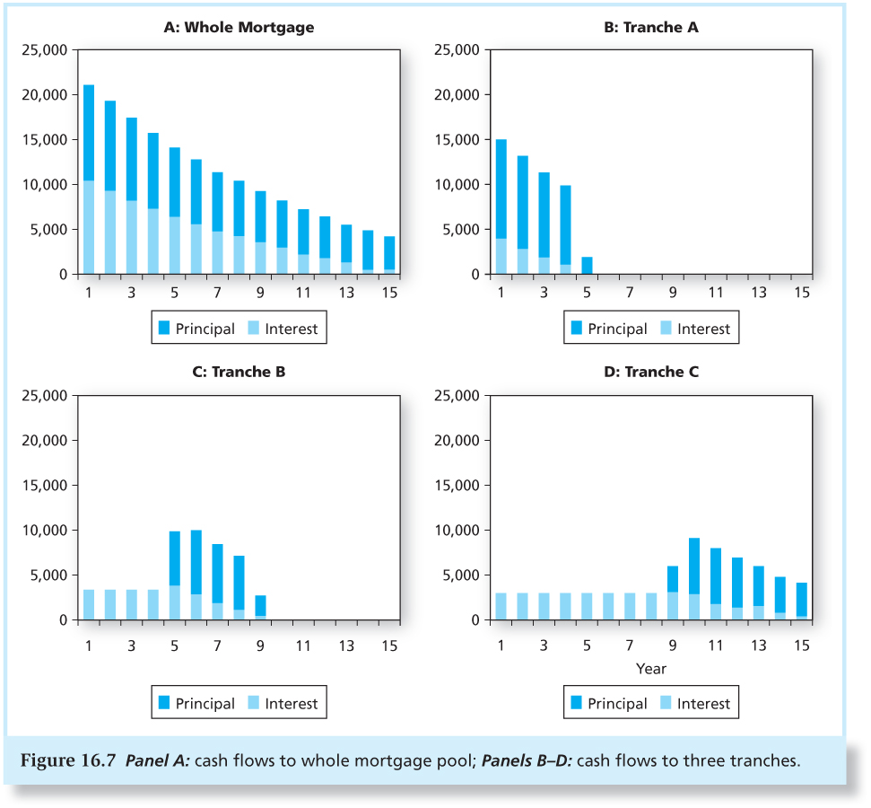
Figure 16.7 Cash Flows to Whole Mortgage
Pool; Cash Flows to Three Tranches

Slide 28
Passive Management
Two passive bond portfolio strategies:
Indexing
Immunization
Both strategies see market prices as being correct, but the strategies have very different risks.

Slide 29
Bond Index Funds
Bond indexes contain thousands of issues, many of which are infrequently traded.
Bond indexes turn over more than stock indexes as the bonds mature.
Therefore, bond index funds hold only a representative sample of the bonds in the actual index.

Slide 30
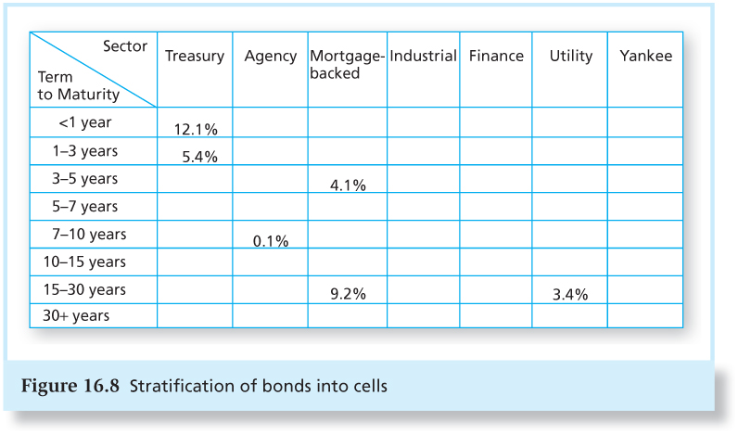
Figure 16.8 Stratification of
Bonds into Cells

Slide 31
Immunization
Immunization is a way to control interest rate risk.
Widely used by pension funds, insurance companies, and banks.

Slide 32
Immunization
Immunize a portfolio by matching the interest rate exposure of assets and liabilities.
  This means: Match the duration of the assets and liabilities.
  Price risk and reinvestment rate risk exactly cancel out.
Result: Value of assets will track the value of liabilities whether rates rise or fall.

Slide 33
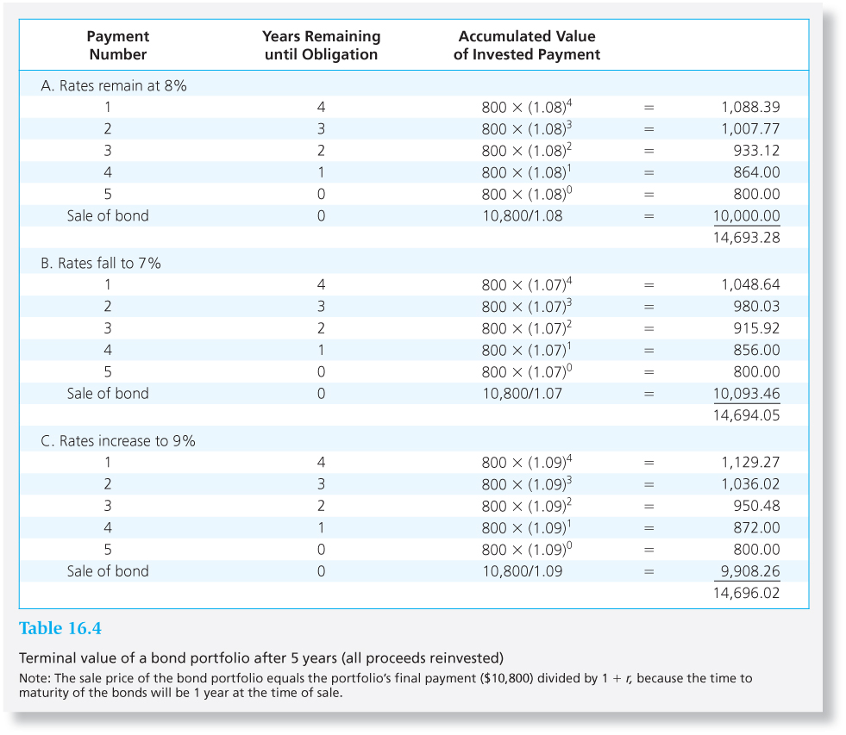
Table 16.4 Terminal value of a Bond Portfolio After 5 Years

Slide 34
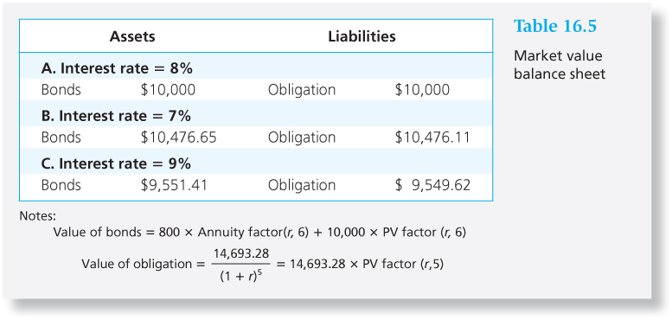
Table 16.5 Market Value Balance Sheet

Slide 35
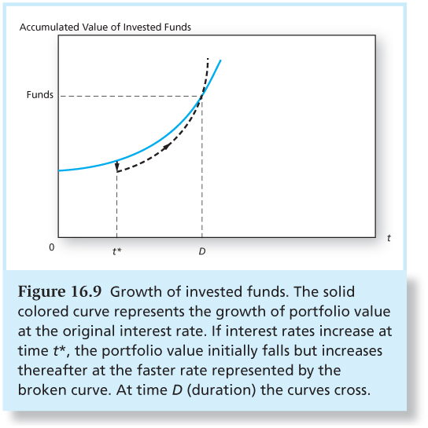
Figure 16.9 Growth of Invested Funds

Slide 36
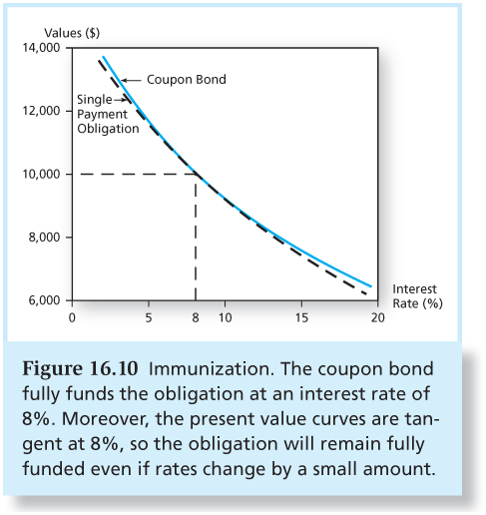
Figure 16.10 Immunization

Slide 37
Cash Flow Matching and Dedication
Cash flow matching = automatic immunization.
Cash flow matching is a dedication strategy.
Not widely used because of constraints associated with bond choices.

Slide 38
Active Management:
Swapping Strategies
Substitution swap
Intermarket swap
Rate anticipation swap
Pure yield pickup
Tax swap

Slide 39
Horizon Analysis
Select a particular holding period and predict the yield curve at end of period.
Given a bond’s time to maturity at the end of the holding period,
  its yield can be read from the predicted yield curve and the end-of-period price can be calculated.

